Slide 1
Damping Influenced level attraction
Yutong Zhao
Aug 19th 2019

Slide 2
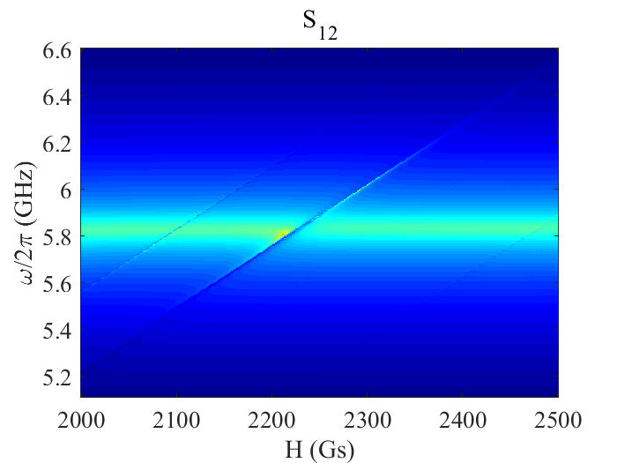
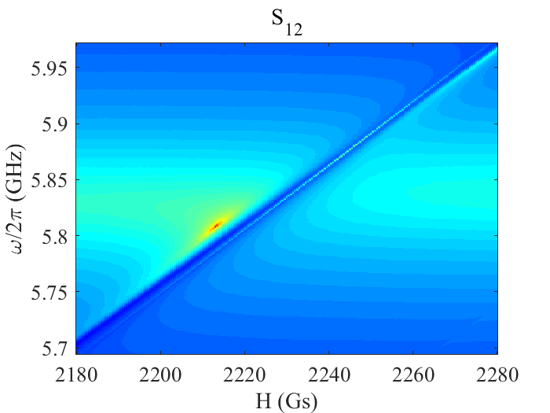
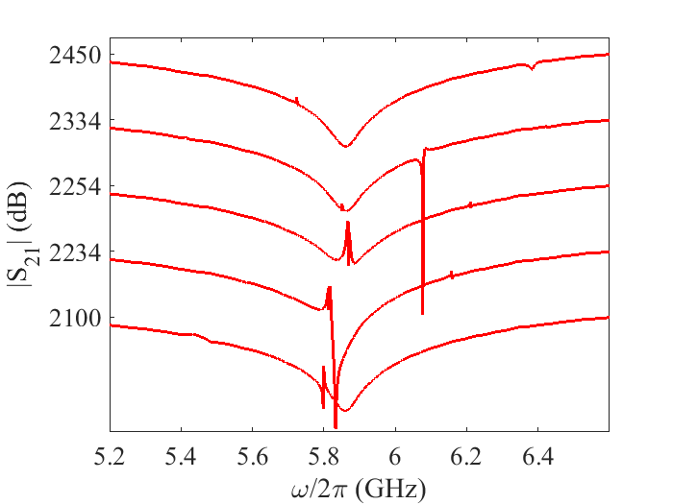
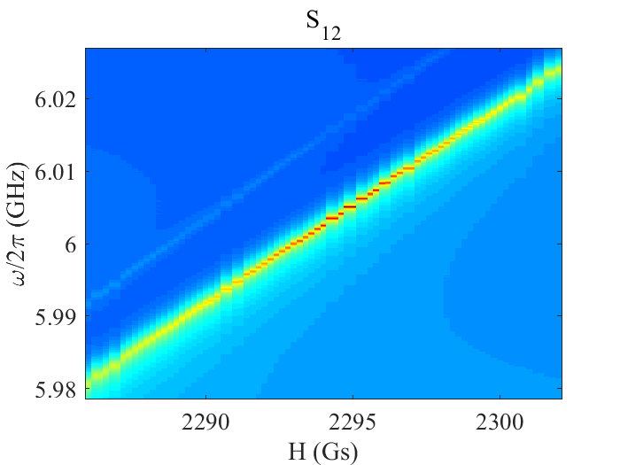


Measured mapping
Experiment setup
Center ZDC
Front view
A
$$\vec{B}$$
Cross cavity
B
YIG
A
P₁
P₂
P₃:loop
Typical spectra
Side ZDC
B
Bottom view
P₃:loop
$$\vec{B}$$
YIG
P₁
P₂
Cross cavity
30 dB

Slide 3
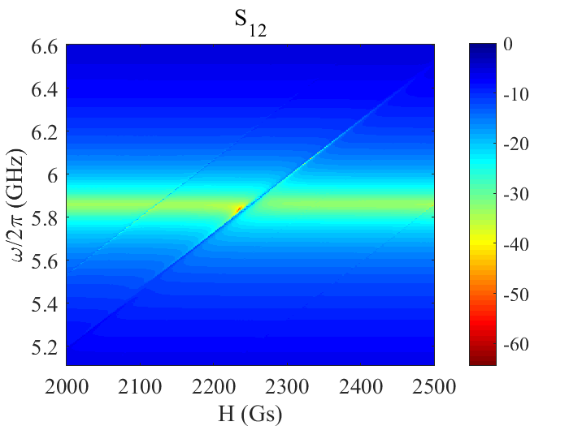
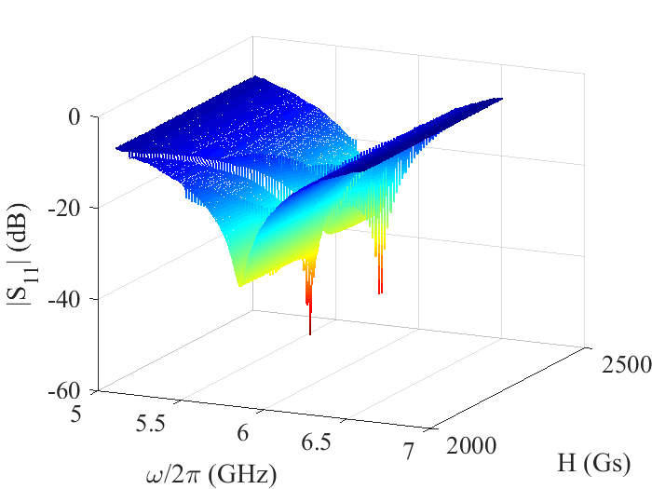
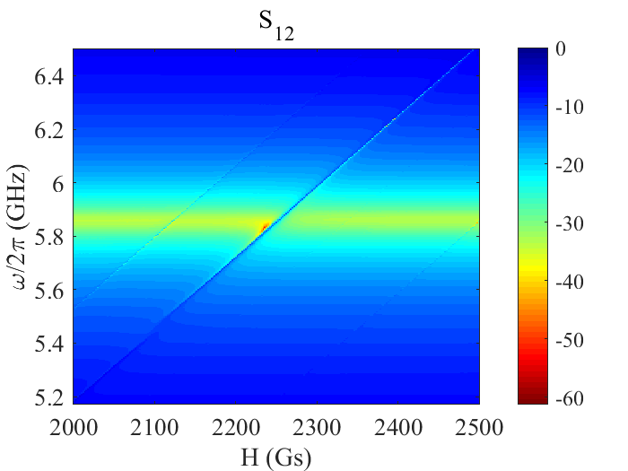
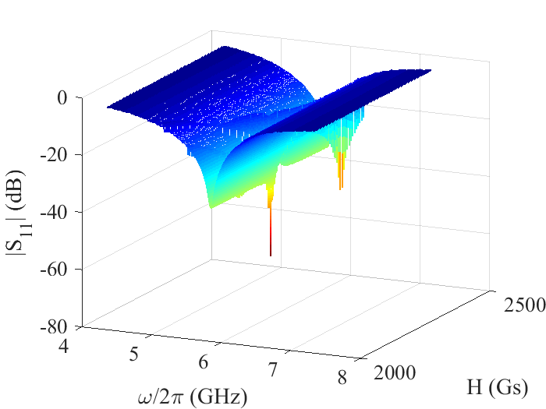


Data2: Loop near
S₁₂ waterfall
P₃:loop
$$\vec{B}$$
YIG
Side ZDC
P₁
P₂
Cross cavity
Center ZDC
Data: Loop far
S₁₂ waterfall
P₃:loop
$$\vec{B}$$
YIG
P₁
P₂
Side ZDC
Cross cavity
Center ZDC

Slide 4
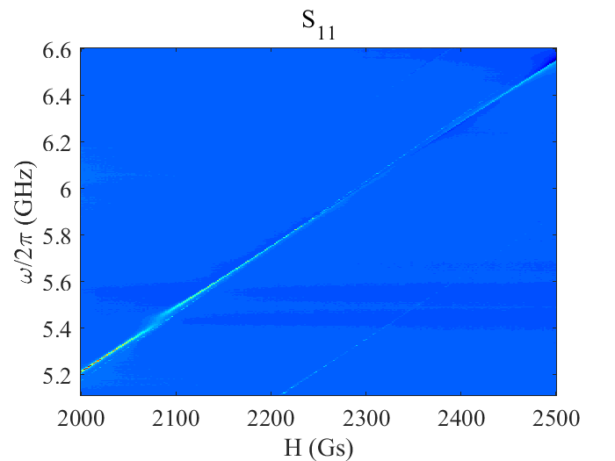
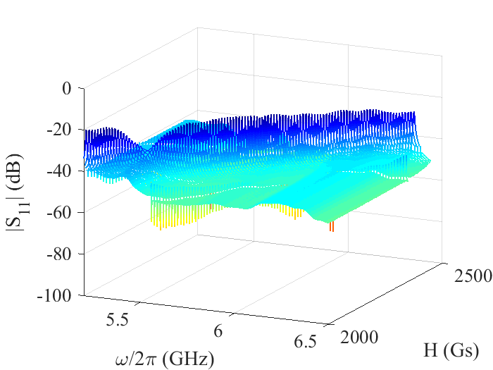
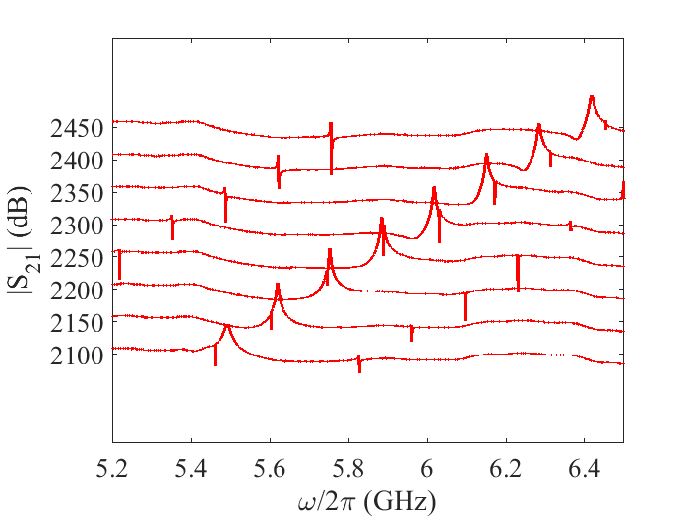

S₃₃
Signal Read out from Port 3
P₃:loop
$$\vec{B}$$
YIG
P₁
P₂
Cross cavity
MW input
S₃₃ waterfall
S₃₃ typical spectra
|S₁₁|
|S₃₃|
|S₃₃|

Slide 5
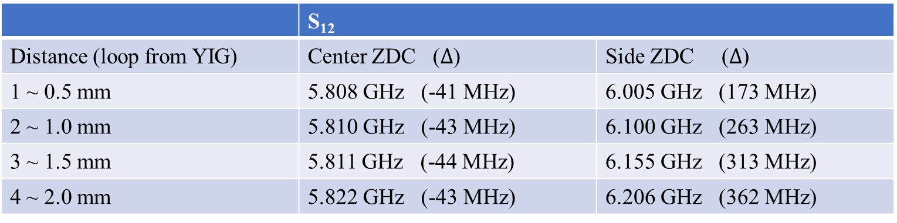
Summary
 | S₁₂
Distance (loop from YIG) | Center ZDC ($Δ$) | Side ZDC ($Δ$)
1 ~ 0.5 mm | 5.808 GHz (-41 MHz) | 6.005 GHz (173 MHz)
2 ~ 1.0 mm | 5.810 GHz (-43 MHz) | 6.100 GHz (263 MHz)
3 ~ 1.5 mm | 5.811 GHz (-44 MHz) | 6.155 GHz (313 MHz)
4 ~ 2.0 mm | 5.822 GHz (-43 MHz) | 6.206 GHz (362 MHz)
The damping of YIG sphere can be modified by adding a magnetic probe and controlling the distance.
The Zero Damping Condition (ZDC) will be influenced.
Next step
Continue the experiment and analysis the data, check how the coupling is changed.
Confirm the damping change by using a transmission line.

Slide 6
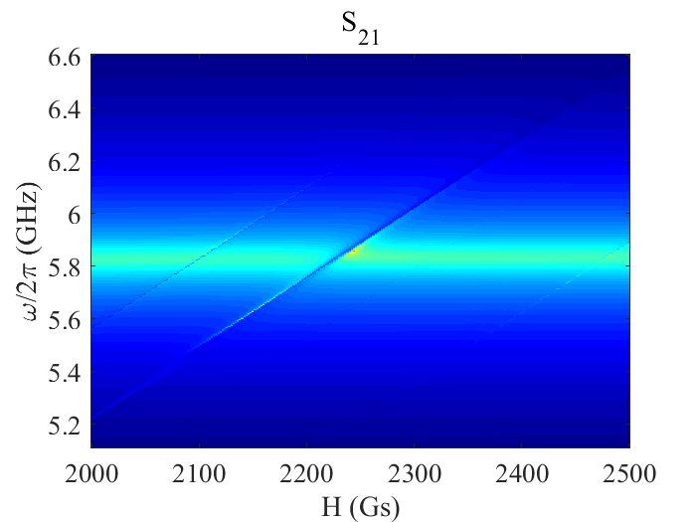
A
Coupling influenced area

